Slide 1


SECURE SOFTWARE DEVELOPMENT (SSD)
Diploma in CSF
Academic Year (AY) 20/21 – Semester 3 (April `20)
Week 2
Secure software concepts
Last Updated: 26/04/2020

Slide 2
Contents
Holistic Security
Mission 3.3: Your First Razor Pages Application
Mission 2.1: Secure Software Concepts
Secure Software Implementation Challenges
Introduction to Razor Pages
Remote Learning Instructions

Slide 3
Remote Learning Instructions
Step 1
Read Holistic Security
Details in slide 5-6
Step 2
Read Secure Software Implementation Challenges
Details in slide 7-10
Step 3
Read Intro to Razor Pages
Details in slide 11
Attempt Open-Ended Question (Slide 12)
Step 4
Do Mission 2.1
Details in slide 13
Do Mission 3.3
Details in slide 14
Step 5
Do Reflection
Details in slide 16

Slide 4
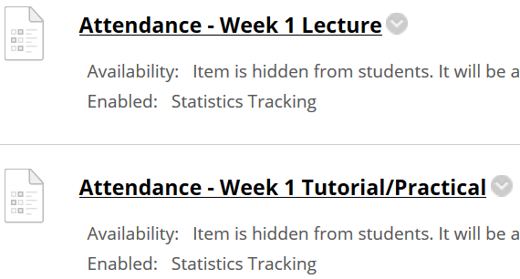
Important Details
VERY IMPORTANT
Visit MEL to start each week’s lesson. Learning materials will ONLY be released in MEL
Attendance Poll Attempt TWO attendance polls every week Starts Monday (9am) till Friday (11:59pm) Attendance :– Week x Lecture ( x refers to week number) Week x Tutorial/Practical Just click “Save and Submit”
Always lookout for announcements Do keep abreast of announcements in MEL
In light of the Covid-19 situation, your cooperation in adhering to the points mentioned is much needed and greatly appreciated.

Slide 5
Holistic Security
The need is for secure applications running on secure hosts (systems) in secure networks.
Source: Official (ISC)² Guide To The CSSLP CBK - Second Edition – by Mano Paul

Slide 6
Holistic Security
For example:
A Structured Query Language (SQL) injection vulnerability in the application can allow an attacker to be able to compromise the database server (host) and from the host, launch exploits that impact the entire network.
Similarly an open port on the network can lead to the discovery and exploitation of unpatched host systems and vulnerabilities in applications.
Secure software is characterized by the securing of applications, hosts and networks holistically, so there is no weak link.
In this module we focus on securing the applications.
Read Holistic Security

Slide 7
Secure Software Implementation Challenges
Iron Triangle Constraints
Scope
Schedule
Cost
Security as an afterthought
Security vs. Usability

Slide 8
Iron Triangle Constraints
If the software development project’s scope, schedule (time), and budget are very rigidly defined (as is often the case), it gives little to no room to incorporate even the basic, let alone additional security requirements into the software and unfortunately what is typically overlooked are elements of software security.

Slide 9
Security as an afterthought
It is important that secure features are built into the software, instead of being added on at a later stage, since it has been proven that the cost to fix insecure software earlier in the software development life cycle (SDLC) is insignificant when compared to having the same issue addressed at a later stage of the SDLC.

Slide 10
Security vs. Usability
Another reason as to why it is a challenge to incorporate secure features in software is that the incorporation of secure features is viewed as rendering the software to become very complex, restrictive and unusable.
There is absolutely no doubt that the incorporation of security comes at the cost of performance and usability. This is true if the software design does not factor in the concept known as “psychological acceptability”. Software security must be balanced with usability and performance.

Slide 11
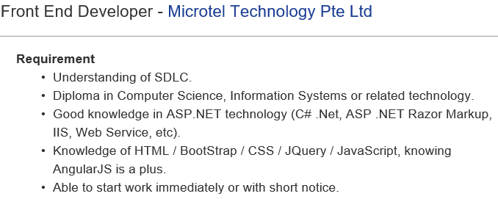
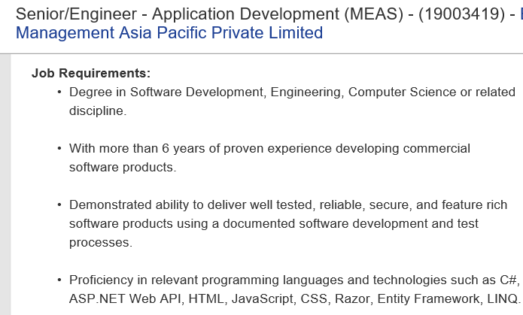
Introduction to Razor Pages
Why study Razor Pages?
Razor Pages makes coding page-focused scenarios easier and more productive.
There’s industry demand for Razor Pages developer.

Slide 12
Open-Ended Question
Qn: The proverbial wisdom is that security is as good as the weakest link. In truth, this actually refers to holistic security.
Do you agree with statement above? Explain with reason(s).
Go to Teams, create channel Week 2 (if not yet created)
In Week 2 channel, post question above in Teams in conversation, if not posted yet. (SSD module rep, please paste question, if not posted yet)
Answer question above in the Week 2 conversation. Do not create a separate conversation thread for the question.
Discuss/Comment on the answers given in the conversation thread .

Slide 13
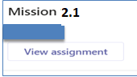
Mission 2.1: Secure Software Concepts (CIA-AAAA-NP)
Research on the following concepts:-
Attacker vs Defender in cybersecurity
What is Confidentiality, Integrity & Availability (CIA)?
What is Authentication, Authorization, Auditing, Accountability?
Explain Non-Repudiation, Data Privacy, Data Anonymization, Personal Data Protection Act.
Suggested websites (list is not exhaustive): -
https://www.hack2secure.com/blogs/an-introduction-to-core-security-concepts-cia-triad-and-aaa
https://cybronys.com/what-is-cia-triad-aaa-security-threats/
Write answers in word document and submit in MEL.
Deadline: Submit at end of Week 2
Penalty for late submission

Slide 14
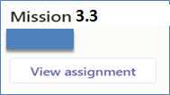
Mission 3.3: Your First Razor Pages Application (Individual)
Please note that Razor Pages mission (Week 1-3) is intentionally released early. The intent is to help you pace learning on Razor Pages.
Visit https://docs.microsoft.com/en-us/aspnet/core/tutorials/razor-pages/
Attempt the following topics:-
Create a Razor Pages web app
Add a model to a Razor Pages app in ASP.NET Core
Scaffolded Razor Pages in ASP.NET Core
Work with a database and ASP.NET Core
Update the generated pages in an ASP.NET Core app
Collate detailed screenshots of each of the completed topic in a word document and submit in MEL (Week 3).
The screenshots must show the browser’s “Address Bar” to verify the application is running in your laptop.
Submit in General → Assignment (Mission 3.3 Razor Pages Intro)
Deadline: Submit at end of Week 3
Note: Refer to document below for changing to NetCore 2.2 if you are using your own visual studio.

Slide 15
Mission 3.3: Your First Razor Pages Application (Individual) – Con’t
Please note that Razor Pages mission (Week 1-3) is intentionally released early. The intent is to help you pace learning on Razor Pages.
Visit https://docs.microsoft.com/en-us/aspnet/core/tutorials/razor-pages/
Attempt the following topics:-
Create a Razor Pages web app
Add a model to a Razor Pages app in ASP.NET Core
Scaffolded Razor Pages in ASP.NET Core
Work with a database and ASP.NET Core
Update the generated pages in an ASP.NET Core app
Guided Videos (Visual Studio 2017)
https://www.youtube.com/watch?v=F0SP7Ry4flQ
https://www.youtube.com/watch?v=sFVIsdR_RcM
https://www.youtube.com/watch?v=zxgKjPYnOMM
https://www.youtube.com/watch?v=A_5ff11sDHY
https://www.youtube.com/watch?v=yLnnleREMtQ
For Visual Studio 2019, refer to attached guide to create/start project in Visual Studio 2019. Once project created in 2019, you can follow steps as per guided worksheet.

Slide 16
Reflections - Individual
Reflect on Week 1 and Week 2 lessons
Inside your “SSD-AY1920-xxx-Pxx → Week 2”
Create another Wiki/OneNote tab “Your Name - Reflection”, and answer the following questions.
Identify 3 important learning points acquired from Week 1 and 2 lessons.
What do these learning points imply? Or what conclusions could you draw?
What will you do more of, less of, start or stop the next time? (In the context of the learning acquired thus far)
Deadline: Before the next week’s lesson

